Slide 1
Applied Data Science Capstone
Restaurant Recommending System

Slide 2
Methodologies
Recommender System
Machine Learning
Exploratory Data Analysis
Inferential Analysis

Slide 3
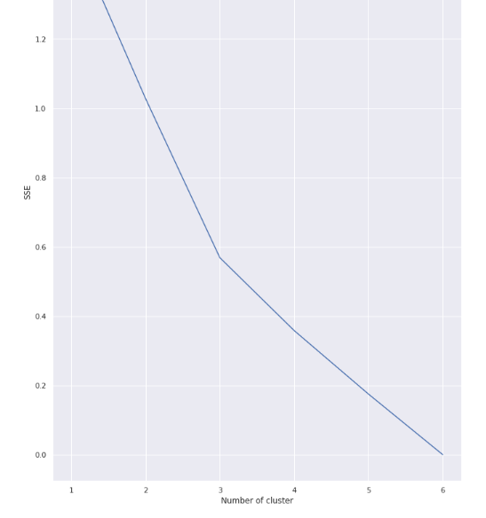
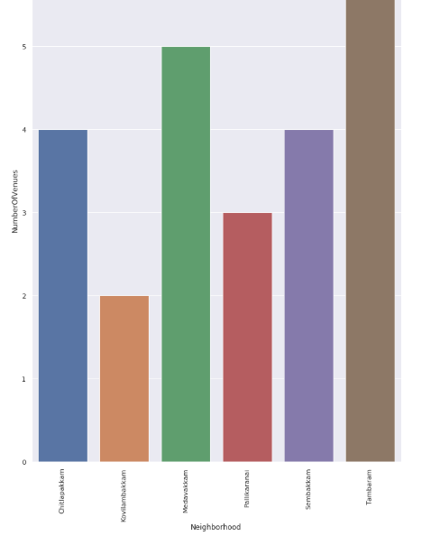
Inferential Data Analysis

Slide 4
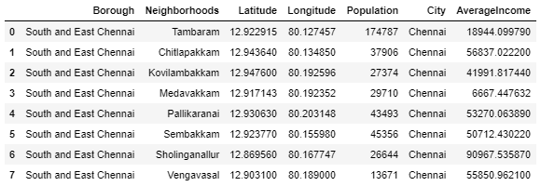
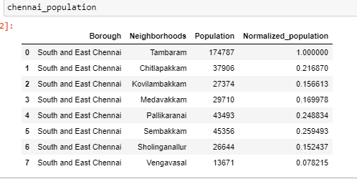
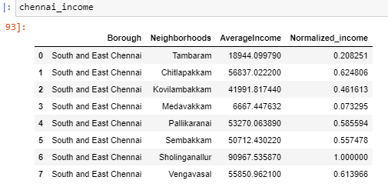
Data

Slide 5
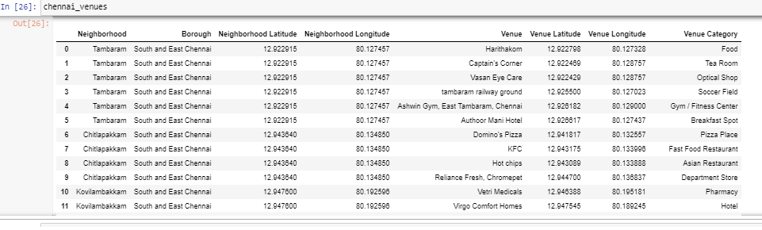

Slide 6
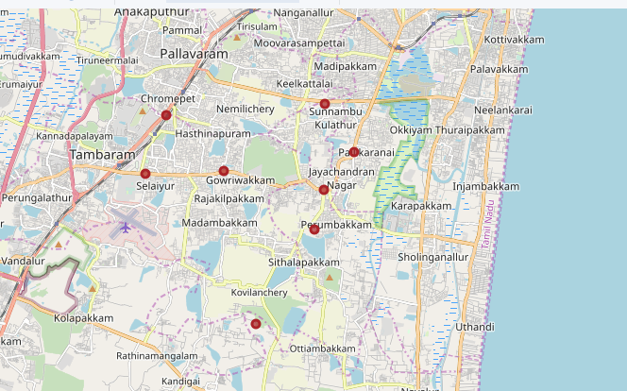
Mapping and Clustering

Slide 7

Results

Slide 8
Thank You

